Slide 1


Flipkart plant sellers analysis
-Ishant Chouhan

Slide 2
Objective
The main objective of this project is to provide a detailed analysis over the over the plant seller’s data obtained by web scrapping (through Flipkart).
It gives detailed analysis over different prices, Sellers, plant type, ratings, plant size.
It covers:
Data Wrangling/Cleaning
Data Visualization
Statistics
Outliers(Box and Whiskers)
Histograms

Slide 3
Data information
Data contains information about sellers and their plants.
Such as,
Id
Name
Plant size
Plant location
Plant type
Prices-
Original price
Discount price and percentage
Special price

Slide 4
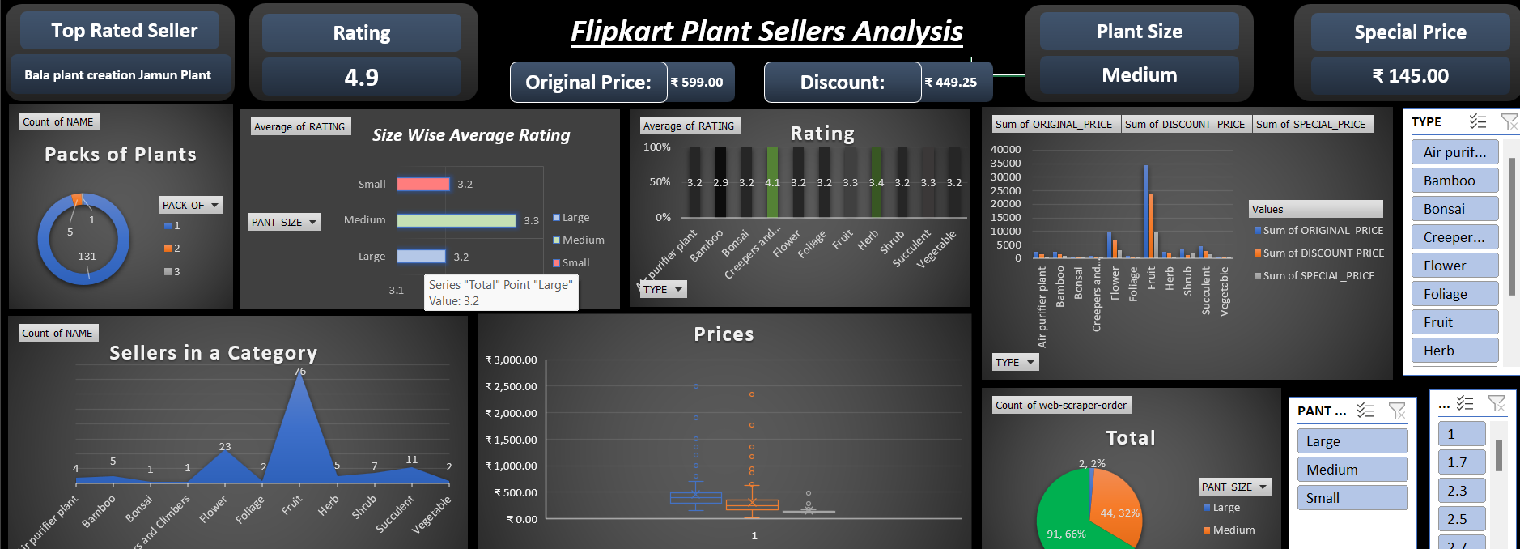
Dashboard

Slide 5
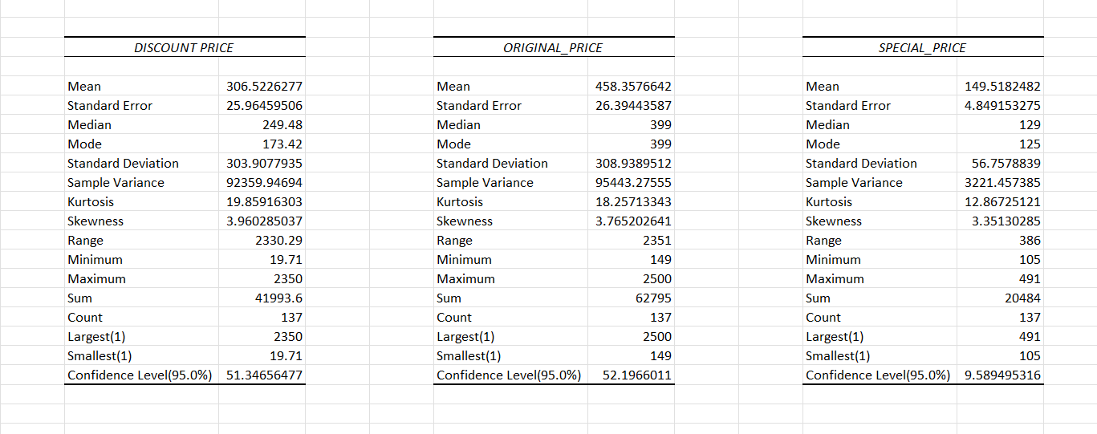
Discriptive statistics
Disciptive Statistics actually shows the Mean, median, Mode, Variance, Deviation, etc.
This is a Detailed structure of data.

Slide 6
Catrgory Wise sellers
This Graph is showing count of sellers in a category/type
Maximum sellers are engaged in Fruit plants
Secondly in flower plants
In rest of the categories competition is very low

Slide 7
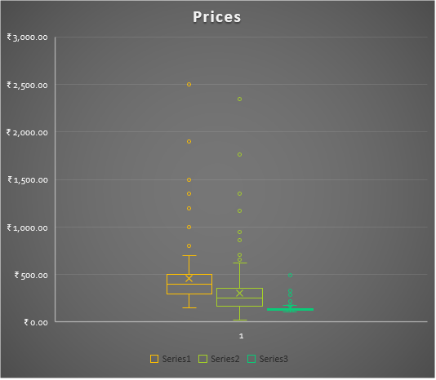
Prices comparison and outliers
There is a comparison of different prices, Original price, Discount price, Special Price.
Box and Whiskers of Special price are very small compare with the Discount and Original prices, which means very heavy discount has been there.
It might be a festive season.

Slide 8


Thank you

